Slide 1
Computing functions with Turing machines

Slide 2
Turing Machines with Outputs
When we begin the computation the tape contains the input.
When the TM accepts (halts) return what is written in the tape.
TM doesn’t reject in any input.

Slide 3
Number representation
Decimal: 12
Binary: 1100
Unary: 111111111111
The unary is space consuming so generally we prefer binary.
When we don’t care about resources it is more convenient to use unary (easier to manipulate with TMs).

Slide 4
Total and Partial Functions
A function f : N → N is total (or just function) when f(n) is defined for every n
Example: f(n) = 2n
f
0
0
1
2
N
2
4
N
3
6
4
8
…
…

Slide 5
Total and Partial Functions
A function f : N → N is called partial when f(n) is defined for some n.
Example: f(n) = logn
f
1
0
0
2
1
3
N
6
4
2
N
5
7
3
9
8
3
…
…

Slide 6
Computable and Partially Computable Functions
A (total) function f : N → N is (total) computable if we can find a Turing Machine that computes it (given any number n in Unary as input in the tape, after completing the computation the tape contains f(n) in Unary).
A partial function f : N → N is said to be partially computable if there is a Turing Machine that partially computes it (if f is defined for n then the machine should output f(n), else it should loop for ever).

Slide 7
Example: f(n) = 2n is computable
We design a TM that computes f(n).
High Level Program:
The tape is divided into input and output (output is right after the first blank after the input)
Repeat:
  Erase one 1 from the input.
  Pass along the rest of the input
  Pass the blank that separates the input from the output.
  Pass along the output until you reach the end (blank).
  write two 1s.
  Go to the beginning of the input.
Until the input is erased (accept).

Slide 8
Example: f(n) = 2n is computable
The machine for f(n) = 2n
1 → 1 , R
1 → 1, R
q₀
1 → □ , R
q₁
□ → □ , R
q₂
□ → 1 , R
□ → □ , R
□ → □ , R
q_{f}
q₅
□ → □ , L
q₄
□ → 1 , L
q₃
1 → 1, L
1 → 1, L

Slide 9
Example: f(n) = 2n is computable
Test input: ε
…
…
1 → 1 , R
1 → 1, R
q₀
1 → □ , R
q₁
□ → □ , R
q₂
□ → 1 , R
□ → □ , R
□ → □ , R
q_{f}
q₅
□ → □ , L
q₄
□ → 1 , L
q₃
1 → 1, L
1 → 1, L

Slide 10
Example: f(n) = 2n is computable
Test input: ε
…
…
1 → 1 , R
1 → 1, R
q₀
1 → □ , R
q₁
□ → □ , R
q₂
□ → 1 , R
□ → □ , R
□ → □ , R
q_{f}
q₅
□ → □ , L
q₄
□ → 1 , L
q₃
1 → 1, L
1 → 1, L

Slide 11
Example: f(n) = 2n is computable
Test input: 11
…
…
1
1
1 → 1 , R
1 → 1, R
q₀
1 → □ , R
q₁
□ → □ , R
q₂
□ → 1 , R
□ → □ , R
□ → □ , R
q_{f}
q₅
□ → □ , L
q₄
□ → 1 , L
q₃
1 → 1, L
1 → 1, L

Slide 12
Example: f(n) = 2n is computable
Test input: 11
…
…
1
1 → 1 , R
1 → 1, R
q₀
1 → □ , R
q₁
□ → □ , R
q₂
□ → 1 , R
□ → □ , R
□ → □ , R
q_{f}
q₅
□ → □ , L
q₄
□ → 1 , L
q₃
1 → 1, L
1 → 1, L

Slide 13
Example: f(n) = 2n is computable
Test input: 11
…
…
1
1 → 1 , R
1 → 1, R
q₀
1 → □ , R
q₁
□ → □ , R
q₂
□ → 1 , R
□ → □ , R
□ → □ , R
q_{f}
q₅
□ → □ , L
q₄
□ → 1 , L
q₃
1 → 1, L
1 → 1, L

Slide 14
Example: f(n) = 2n is computable
Test input: 11
…
…
1
1 → 1 , R
1 → 1, R
q₀
1 → □ , R
q₁
□ → □ , R
q₂
□ → 1 , R
□ → □ , R
□ → □ , R
q_{f}
q₅
□ → □ , L
q₄
□ → 1 , L
q₃
1 → 1, L
1 → 1, L

Slide 15
Example: f(n) = 2n is computable
Test input: 11
…
…
1
1
1 → 1 , R
1 → 1, R
q₀
1 → □ , R
q₁
□ → □ , R
q₂
□ → 1 , R
□ → □ , R
□ → □ , R
q_{f}
q₅
□ → □ , L
q₄
□ → 1 , L
q₃
1 → 1, L
1 → 1, L

Slide 16
Example: f(n) = 2n is computable
Test input: 11
…
…
1
1
1
1 → 1 , R
1 → 1, R
q₀
1 → □ , R
q₁
□ → □ , R
q₂
□ → 1 , R
□ → □ , R
□ → □ , R
q_{f}
q₅
□ → □ , L
q₄
□ → 1 , L
q₃
1 → 1, L
1 → 1, L

Slide 17
Example: f(n) = 2n is computable
Test input: 11
…
…
1
1
1
1 → 1 , R
1 → 1, R
q₀
1 → □ , R
q₁
□ → □ , R
q₂
□ → 1 , R
□ → □ , R
□ → □ , R
q_{f}
q₅
□ → □ , L
q₄
□ → 1 , L
q₃
1 → 1, L
1 → 1, L

Slide 18
Example: f(n) = 2n is computable
Test input: 11
…
…
1
1
1
1 → 1 , R
1 → 1, R
q₀
1 → □ , R
q₁
□ → □ , R
q₂
□ → 1 , R
□ → □ , R
□ → □ , R
q_{f}
q₅
□ → □ , L
q₄
□ → 1 , L
q₃
1 → 1, L
1 → 1, L

Slide 19
Example: f(n) = 2n is computable
Test input: 11
…
…
1
1
1
1 → 1 , R
1 → 1, R
q₀
1 → □ , R
q₁
□ → □ , R
q₂
□ → 1 , R
□ → □ , R
□ → □ , R
q_{f}
q₅
□ → □ , L
q₄
□ → 1 , L
q₃
1 → 1, L
1 → 1, L

Slide 20
Example: f(n) = 2n is computable
Test input: 11
…
…
1
1
1
1 → 1 , R
1 → 1, R
q₀
1 → □ , R
q₁
□ → □ , R
q₂
□ → 1 , R
□ → □ , R
□ → □ , R
q_{f}
q₅
□ → □ , L
q₄
□ → 1 , L
q₃
1 → 1, L
1 → 1, L

Slide 21
Example: f(n) = 2n is computable
Test input: 11
…
…
1
1
1 → 1 , R
1 → 1, R
q₀
1 → □ , R
q₁
□ → □ , R
q₂
□ → 1 , R
□ → □ , R
□ → □ , R
q_{f}
q₅
□ → □ , L
q₄
□ → 1 , L
q₃
1 → 1, L
1 → 1, L

Slide 22
Example: f(n) = 2n is computable
Test input: 11
…
…
1
1
1 → 1 , R
1 → 1, R
q₀
1 → □ , R
q₁
□ → □ , R
q₂
□ → 1 , R
□ → □ , R
□ → □ , R
q_{f}
q₅
□ → □ , L
q₄
□ → 1 , L
q₃
1 → 1, L
1 → 1, L

Slide 23
Example: f(n) = 2n is computable
Test input: 11
…
…
1
1
1 → 1 , R
1 → 1, R
q₀
1 → □ , R
q₁
□ → □ , R
q₂
□ → 1 , R
□ → □ , R
□ → □ , R
q_{f}
q₅
□ → □ , L
q₄
□ → 1 , L
q₃
1 → 1, L
1 → 1, L

Slide 24
Example: f(n) = 2n is computable
Test input: 11
…
…
1
1
1 → 1 , R
1 → 1, R
q₀
1 → □ , R
q₁
□ → □ , R
q₂
□ → 1 , R
□ → □ , R
□ → □ , R
q_{f}
q₅
□ → □ , L
q₄
□ → 1 , L
q₃
1 → 1, L
1 → 1, L

Slide 25
Example: f(n) = 2n is computable
Test input: 11
…
…
1
1
1
1 → 1 , R
1 → 1, R
q₀
1 → □ , R
q₁
□ → □ , R
q₂
□ → 1 , R
□ → □ , R
□ → □ , R
q_{f}
q₅
□ → □ , L
q₄
□ → 1 , L
q₃
1 → 1, L
1 → 1, L

Slide 26
Example: f(n) = 2n is computable
Test input: 11
…
…
1
1
1
1
1 → 1 , R
1 → 1, R
q₀
1 → □ , R
q₁
□ → □ , R
q₂
□ → 1 , R
□ → □ , R
□ → □ , R
q_{f}
q₅
□ → □ , L
q₄
□ → 1 , L
q₃
1 → 1, L
1 → 1, L

Slide 27
Example: f(n) = 2n is computable
Test input: 11
…
…
1
1
1
1
1 → 1 , R
1 → 1, R
q₀
1 → □ , R
q₁
□ → □ , R
q₂
□ → 1 , R
□ → □ , R
□ → □ , R
q_{f}
q₅
□ → □ , L
q₄
□ → 1 , L
q₃
1 → 1, L
1 → 1, L

Slide 28
Example: f(n) = 2n is computable
Test input: 11
…
…
1
1
1
1
1 → 1 , R
1 → 1, R
q₀
1 → □ , R
q₁
□ → □ , R
q₂
□ → 1 , R
□ → □ , R
□ → □ , R
q_{f}
q₅
□ → □ , L
q₄
□ → 1 , L
q₃
1 → 1, L
1 → 1, L

Slide 29
Example: f(n) = 2n is computable
Test input: 11
…
…
1
1
1
1
1 → 1 , R
1 → 1, R
q₀
1 → □ , R
q₁
□ → □ , R
q₂
□ → 1 , R
□ → □ , R
□ → □ , R
q_{f}
q₅
□ → □ , L
q₄
□ → 1 , L
q₃
1 → 1, L
1 → 1, L

Slide 30
Example: f(n) = 2n is computable
Test input: 11
…
…
1
1
1
1
1 → 1 , R
1 → 1, R
q₀
1 → □ , R
q₁
□ → □ , R
q₂
□ → 1 , R
□ → □ , R
□ → □ , R
q_{f}
q₅
□ → □ , L
q₄
□ → 1 , L
q₃
1 → 1, L
1 → 1, L

Slide 31
Example: f(n) = 2n is computable
Test input: 11
…
…
1
1
1
1
1 → 1 , R
1 → 1, R
q₀
1 → □ , R
q₁
□ → □ , R
q₂
□ → 1 , R
□ → □ , R
□ → □ , R
q_{f}
q₅
□ → □ , L
q₄
□ → 1 , L
q₃
1 → 1, L
1 → 1, L

Slide 32
Example: f(n) = 2n is computable
Test input: 11
…
…
1
1
1
1
1 → 1 , R
1 → 1, R
q₀
1 → □ , R
q₁
□ → □ , R
q₂
□ → 1 , R
□ → □ , R
□ → □ , R
q_{f}
q₅
□ → □ , L
q₄
□ → 1 , L
q₃
1 → 1, L
1 → 1, L

Slide 33
Example: f(n) = logn is partially computable.
We design a TM that partially computes f(n).
High Level Program:
Add a $ in the beginning and the end of the input (this will make the task of going from one state to another easier)
Repeat:
  For every two ones in the input erase the first and leave the second there.
  If there was an odd > 1 number of 1s then loop for ever (the function is undefined)
  If the number of 1 is even then pass the $ sign
  Pass along the output until you reach the end (blank).
  Write one 1 in the output (after the $).
  Go to the beginning of the input.
Until there is only one 1 in the input.
Erase the two $ signs and accept.

Slide 34
Example: f(n) = logn is partially computable.
□ → □ , R
$ → □ , L
q_{f}
$_{E}
1 → 1 , R
$ → □ , L
□ → □ , R
1 → □ , R
□ → □ , R
□ → □ , R
$ → $ , S
$_{R}
1
ev
od
1 → 1 , R
1 → 1 , R
□ → $ , L
1 → □ , R
$ → $ , R
$ → $ , L
L
$ → $ , L
$_{L}
□ → $ , R
0
ou
1 → 1, R
□ → 1 , L
1 → 1 , L
□ → □ , L
$
1 → 1, L
□ → □ , R
1 → 1, L

Slide 35
Example: f(n) = logn is partially computable.
Try to run the machine by hand
Test inputs:
ε (shouldn’t accept)
1 (should accept)
11 (should accept)
111 (shouldn’t accept)
111111 (shouldn’t accept)
11111111 (should accept)

Slide 36
k-ary functions
A function f might have more than one parameters.
f: N x N x … x N → N is called k-ary function
Examples:
+ : N x N → N (addition of integers) is a binary function.
k times

Slide 37
Representation of a k-tuple in a DTM
A k-tuple (x₁ , x₂ , …, x_{k}) can be represented in a Turing Machine by the following way:
Example: (2, 4)
x₁
x₂
x_{k}
…
…
1
1
…
1
0
1
…
1
0
…
1
…
1
head
…
…
1
1
0
1
1
1
1

Slide 38
Binary addition is computable
High level program:
  Remove the 0 from the middle and make the 1s in the input consecutive.
TM for this function:
1 → 1, R
1 → 1, R
1 → 1, R
q₀
0 → 1 , R
q₁
□ → □ , L
q₂
1 → □ , R
q_{f}

Slide 39
Binary addition is computable
Test input: (2, 3) = 110111
…
…
1
1
0
1
1
1
1 → 1, R
1 → 1, R
1 → 1, R
q₀
0 → 1 , R
q₁
□ → □ , L
q₂
1 → □ , R
q_{f}

Slide 40
Binary addition is computable
Test input: (2, 3) = 110111
…
…
1
1
0
1
1
1
1 → 1, R
1 → 1, R
q₀
0 → 1 , R
q₁
□ → □ , L
q₂
1 → □ , R
q_{f}

Slide 41
Binary addition is computable
Test input: (2, 3) = 110111
…
…
1
1
0
1
1
1
1 → 1, R
1 → 1, R
q₀
0 → 1 , R
q₁
□ → □ , L
q₂
1 → □ , R
q_{f}

Slide 42
Binary addition is computable
Test input: (2, 3) = 110111
…
…
1
1
1
1
1
1
1 → 1, R
1 → 1, R
q₀
0 → 1 , R
q₁
□ → □ , L
q₂
1 → □ , R
q_{f}

Slide 43
Binary addition is computable
Test input: (2, 3) = 110111
…
…
1
1
1
1
1
1
1 → 1, R
1 → 1, R
q₀
0 → 1 , R
q₁
□ → □ , L
q₂
1 → □ , R
q_{f}

Slide 44
Binary addition is computable
Test input: (2, 3) = 110111
…
…
1
1
1
1
1
1
1 → 1, R
1 → 1, R
q₀
0 → 1 , R
q₁
□ → □ , L
q₂
1 → □ , R
q_{f}

Slide 45
Binary addition is computable
Test input: (2, 3) = 110111
…
…
1
1
1
1
1
1
1 → 1, R
1 → 1, R
q₀
0 → 1 , R
q₁
□ → □ , L
q₂
1 → □ , R
q_{f}

Slide 46
Binary addition is computable
Test input: (2, 3) = 110111
…
…
1
1
1
1
1
1
1 → 1, R
1 → 1, R
q₀
0 → 1 , R
q₁
□ → □ , L
q₂
1 → □ , R
q_{f}

Slide 47
Binary addition is computable
Test input: (2, 3) = 110111
…
…
1
1
1
1
1
1 → 1, R
1 → 1, R
q₀
0 → 1 , R
q₁
□ → □ , L
q₂
1 → □ , R
q_{f}

Slide 48
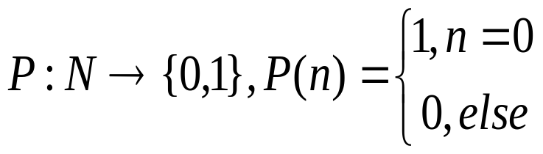
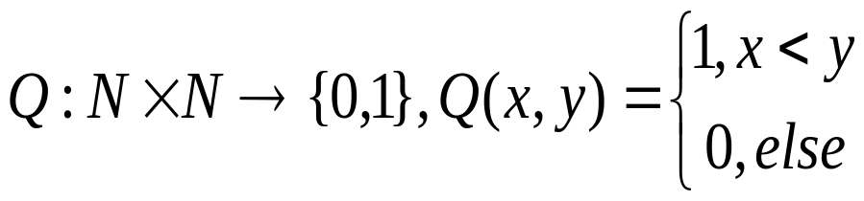
Predicates
Predicate: A Boolean (yes-no) function.
P : N → {0,1}
Examples
  Unary predicate
  k-ary predicate
Partial Predicates: Predicates with unique value that are not defined for some input.

Slide 49
Computable Predicates
A predicate P is computable if it can be computed by a Turing Machine
  a) There is a Turing Machine that, given its parameters n₁, …, n_{k} as input it outputs P(n₁, …, n_{k})
  b) There is a Turing Machine that decides P (in other words accepts if the output is 1 and rejects if the output is 0.
The 2 definitions are equivalent. We use the second one.

Slide 50
P(n) is computable
High level program:
  If the tape is empty accept else reject
Turing Machine:
q₀
□ → □ , R
q_{f}

Slide 51
Q(x,y) is computable
High level program:
  - Remove one 1 from both x and y. If you can do that for all the 1s in x then accept, else reject.
TM for this predicate:
0 → 0 , R
1 → 1, R
x → x, R
x → x, L
q₀
1 → x , R
q₁
0 → 0 , R
q₂
1 → x , L
q₃
□ → □ , R
q_{f}
1 → 1, L
x → x, R
q₄
1 → 1, L

Slide 52
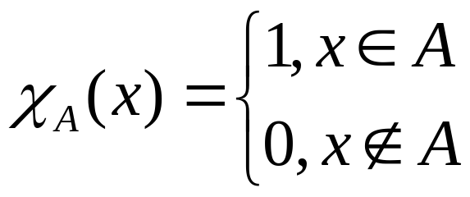
Computable Sets, Characteristic function
The characteristic function χ_{Α} of a set A is defined as follows:
A set is computable if its characteristic function is computable.

Slide 53
Computable Languages
A language is computable if its characteristic function is computable (we can use a Turing Machine to decide membership)
For example {a^{n}b^{n} , n≥0} is a computable language because there is a Turing Machine that, given any string in Σ* it decides whether the string belongs in the language or not.

Slide 54
Partially Computable Languages
Partially Computable Predicates: There is a Turing Machine that for output 1 it accepts (halts) and for ↑ it loops for ever.
Partially Computable Languages: The characteristic function is partially computable (languages that are accepted by Turing Machines).

Slide 55
Counting Infinite sets
We say that two infinite sets A, B are of the same size if there is an one to one and onto function from A to B (or from B to A)
We say that an infinite set A is at most as large as another infinite set B if we can find an one to one function from A to B.

Slide 56
Examples
|A| = |B| |A| ≤ |B|
a₁
b₁
a₁
b₁
A
a₂
b₂
B
A
a₂
b₂
B
a₃
b₃
a₃
b₃
…
…
…
b₄
…

Slide 57
Countable Sets
A set is countable if you can find an one to one and onto correspondence with the natural numbers (intuitively this means that it has the same number of elements as the natural numbers)
a
1
b
2
A
c
3
N
d
4
e
5
…
…

Slide 58
The set of the even numbers is countable
There is an one to one an onto function from E (the even numbers) to N: f(n) = n/2
f
0
0
2
1
E
N
4
2
6
3
8
4
…
…

Slide 59
N x N is countable
0
1
8
9
24
(0,0)
(0,1)
(0,2)
(0,3)
(0,4)
. . .
3
(1,0)
2
7
10
23
(1,1)
(1,2)
(1,3)
(1,4)
4
(2,0)
(2,1)
(2,2)
(2,3)
(2,4)
6
11
22
5
15
(3,0)
(3,1)
(3,2)
(3,3)
12
(3,4)
21
14
13
16
(4,0)
(4,1)
(4,2)
(4,3)
(4,4)
20
17
18
19
. . .
.
.
.

Slide 60
The set of Turing Machines is countable
Every Turing Machine can be given a unique number in binary as follows:
  Give to the states a number: q₀ is 1, q₁ is 11 etc…
  Give to the symbols of the stack a unique number: a is 1, b is 11, c is 111 etc…
  Assign 1 to L, 11 to R and 111 to S
  For each δ(q, a) = (q’, b, H) give the binary number 11…1011...1011…1011…1011…1
  q a q’ b H
  where H is L, R or S.

Slide 61
The set of Turing Machines is countable
Every Turing Machine can be given a unique number in binary as follows:
  To obtain the number of the machine combine each number for the arrows together (separated with 00).
  The number starts with q₀ 00 q_{f} 00
The number associated with the Turing Machine M is denoted as <M>

Slide 62
Example
The Turing Machine M_{P} that computes the Predicate
P(n) := n=0 has the following number
<M_{P}> = 100110010101101011
?
q₀
□ → □ , R
q_{f}

Slide 63
Uncountable Sets
Countable sets are infinite.
However there are some sets that are considered “even larger”.
There is no way to enumerate them.
Diagonalization method: Suppose that there is an enumeration of all the elements of the set.
Obtain a new element by taking different parts of each element and changing them.
The new element is not in the enumeration.
  Contradiction!!!

Slide 64
The set of N →{0,1} Predicates is not countable
Suppose that it was. An enumeration of all the predicate would be the following:
1 2 3 4 5 6
1 0 1 0 1 1 1 f(1) = 1
2 1 0 1 1 0 0 . . . f(2) = 1
0 0 1 0 1 1 f(3) = 0
1 1 1 0 1 1 f(4) = 1
.
.
.
The predicate f(n) = 1 - f_{n}(n) is not in the enumeration.

Slide 65
Not all predicates are computable
Turing Machines are countable
Predicates are uncountable
Thus there is a predicate for which there is no Turing Machine that decides it.

Slide 66
A predicate that is not computable
The Halting Problem: Given a Turing Machine M and an input x does M halt with input x?
Important problem: If a machine doesn’t stop then we don’t know for sure if it is going to accept the input or not.
It turns out that this problem is not solvable!
In other words we can prove that the predicate Halt is not computable (there is no Turing Machine that takes as input the pair (<M>, x) and decides if M is going to accept on x.

Slide 67
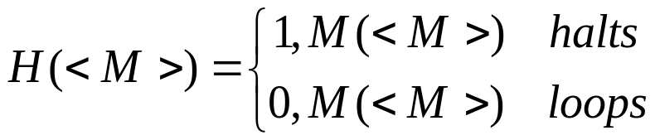
Predicate Halt is not computable
We will prove that the predicate
is not computable.
Suppose that there is a TM H_{TM} that decides H.
In other words, H_{TM}(<M>) halts if H(<M>) = 1 else loops.
Take the machine H’_{TM} which does the opposite: halts on input M if H(<M>) = 0 else loops.
Run H’_{TM} with input the machine H’_{TM} itself.
  H’_{TM} (<H’_{TM}>) is going to halt if H(<H’_{TM}>) = 0 which means that H’_{TM} (<H’_{TM} >) loops.
  H’_{TM} (<H’_{TM}>) is going to loop if H(<H’_{TM}>) = 1 which means that H’_{TM} (<H’_{TM} >) halts.

Slide 68
Important Facts
This method is called self-reference
Thesis Turing-Church implies that any other machine or program can do exactly whatever a Turing Machine can do.
There is no machine or program that can decide whether or not a machine or program is going to halt.
Computers CANNOT decide the halting problem.

Slide 69
Halting problem for Pascal programs
Suppose that there is a Pascal program Halt that takes as input another Pascal program p and decides whether this program is going to halt or not (outputs true if p halts, else false).
Create a new Pascal program Halt’ by adding to Halt the following code:
  while Halt(p)=true do a:=1;
This makes Halt’(p) to loop if p halts and vice versa.

Slide 70
Halting problem for Pascal programs
Of course Halt’ is a proper Pascal program so why not giving it as input to Halt’ (self-reference).
Now:
  If Halt’(Halt’) halts then Halt(Halt’) = true so Halt’(Halt’) is going to loop .
  If Halt’(Halt’) loops then Halt(Halt’) = false so Halt’(Halt’) is going to halt
  Contradiction!!!

Slide 71
Universal Turing Machine
We can create a Turing machine U that takes a pair of numbers (<M>, x) as input and then simulates M running on input x:
  If M accepts on x then U accepts on (<M>, x)
  If M rejects on x then U rejects on (<M>, x)
  If M loops on x then U loops on (<M>, x)
This machine is called a Universal Turing Machine.

Slide 72
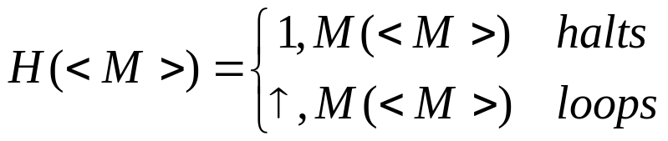
Predicate H is partially computable
The partial predicate
is partially computable.
Run the Universal Turing machine U with input (<M>,<M>).

Slide 73
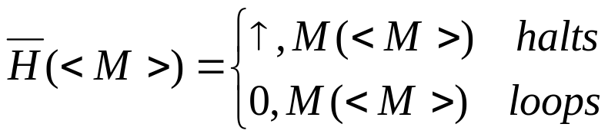

A predicate that is not partially computable
Consider the predicate
is not partially computable
Suppose that there was a TM U’ that could partially compute .
Idea: Run both machines U and U’ on input (<M>,<M>). At some point one of them will halt.
  If U halts then accept
  If U’ halts then reject
But this decides the Halt predicate. Contradiction!
Difficult part: Simulate in one machine the concurrent running of U and U’.

